Slide 1
Using Git
With GitGui
(Available in the labs)
Creating a new Project Repository
Sharing the Repository with the instructor(s)
Downloading Repository from server to harddrive
Adding new files
Creating a commit
Pushing to/Syncing with the server
Pulling new changes

Slide 2
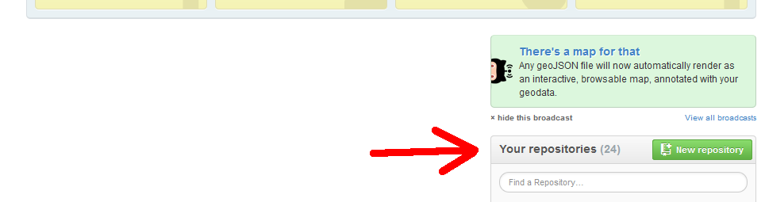
1. Creating a new Project Repository
From https://github.com/, scroll down until you see the green New repository button under the Your repositories section. Click the button.

Slide 3
1. Creating a new Project Repository
On the Create a New Repository page, fill out the following:
  Repository Name: CS201
  Description: Optional
  Select Private radio button
    If it asks for a credit card, you haven't been activated as a student account yet. See week 1 slides
  Check Initialize this repository with a README
  From the dropdown box, select C++ as the language

Slide 4
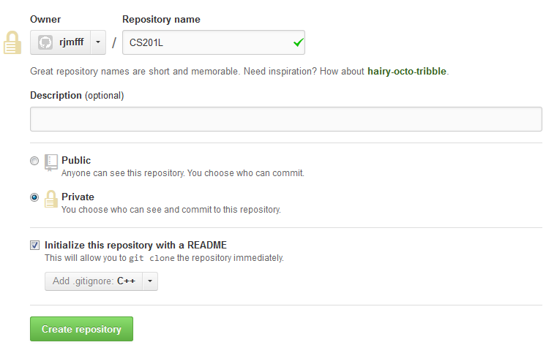
1. Creating a new Project Repository

Slide 5
1. Creating a new Project Repository
You will need to create an additional repository if you're in the CS 201 Lab.
  CS 201
  CS 201 L

Slide 6
2. Sharing your Repositories
For CS 201, you will need to share your repository with Rachel.
For CS 201 L, you will need to share your repository with Imrul and Rachel.

Slide 7
2. Sharing your Repositories
From your Repository website,
https://github.com/YOUR_USERNAME/CS201
Click on the Settings button.

Slide 8
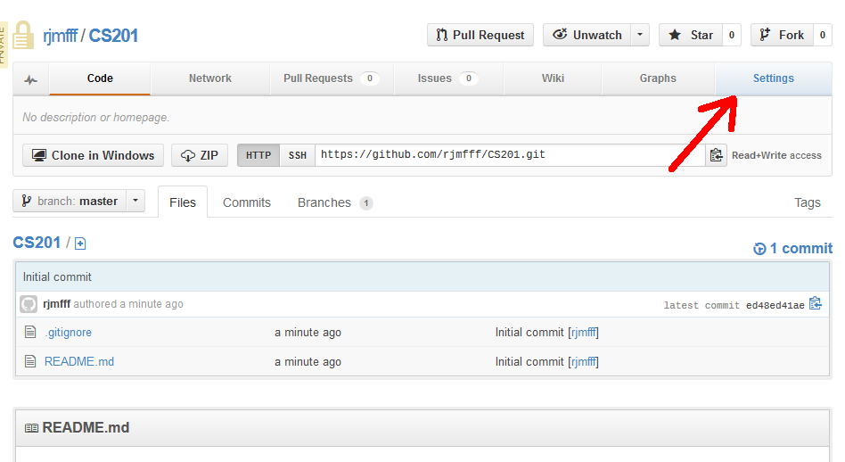
2. Sharing your Repositories

Slide 9
2. Sharing your Repositories
From the Settings page, click on the Collaborators tab.
In the Collaborators tab, enter our IDs:
  RJMFFF for Rachel (CS 201 and CS 201 L)
  Simrul for Imrul
  Usernames are not case-sensitive
Click on the Add button.

Slide 10
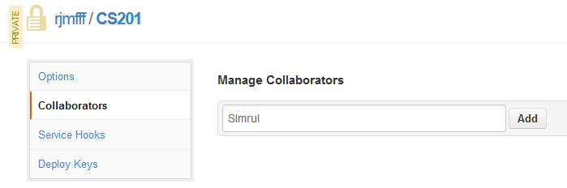
2. Sharing your Repositories

Slide 11
3. Setting up GitGui
Install GitGui on your machine, or it will be available on lab computers already.

Slide 12
4. Downloading your Repository
The repository is currently only on the web server. To add and change files, you need to pull it down to your local machine.
You will modify files on your harddrive, and when you're done with a change, push them back to the server.

Slide 13
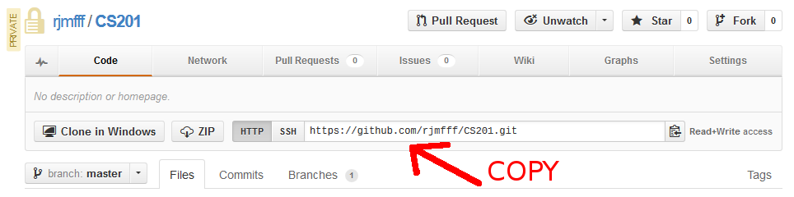
4. Downloading your Repository
From your Repository website,
https://github.com/YOUR_USERNAME/CS201
highlight the .git URL and copy it.

Slide 14
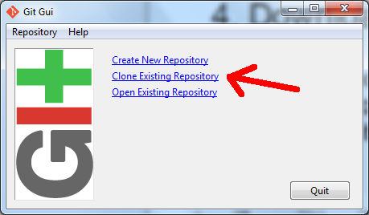
4. Downloading your Repository
Select the Clone Existing Repository option.

Slide 15
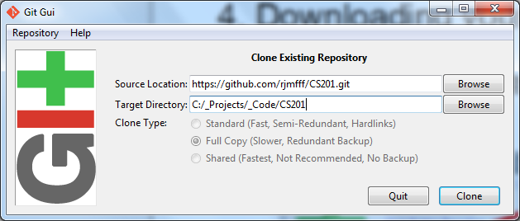
4. Downloading your Repository
Paste the .git URL into Source Location, and find a place on your harddrive under Target Directory.
Click Clone.

Slide 16
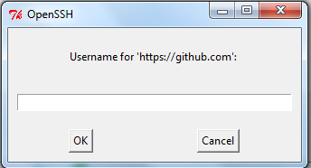
4. Downloading your Repository
It might ask for your username/password three times during the setup.

Slide 17
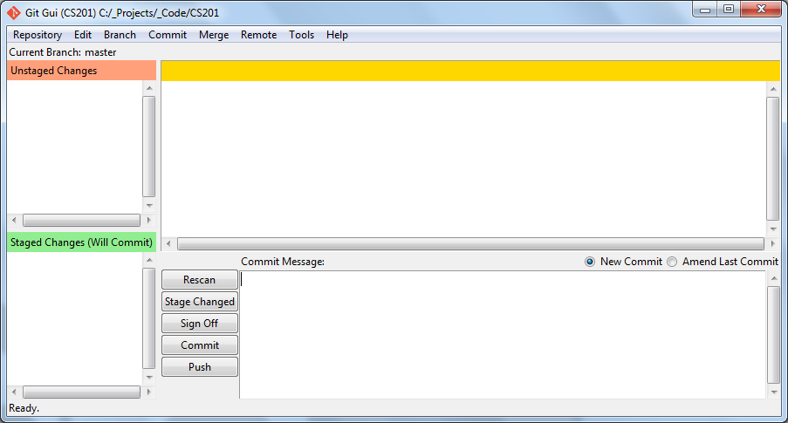
4. Downloading your Repository
When it is done, you will see the main panel:

Slide 18
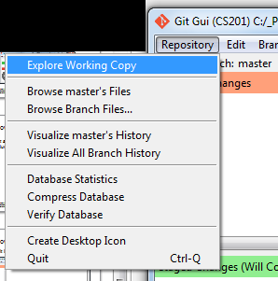
5. Adding a test file
From the main panel, go to the Repository dropdown menu, and click Explore Working Copy. This will open Windows Explorer.

Slide 19
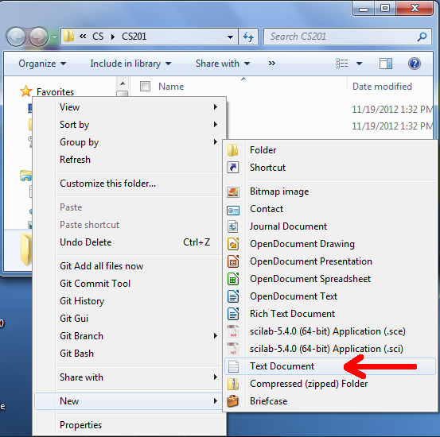
5. Adding a test file
Create a new text document in the repository folder.

Slide 20
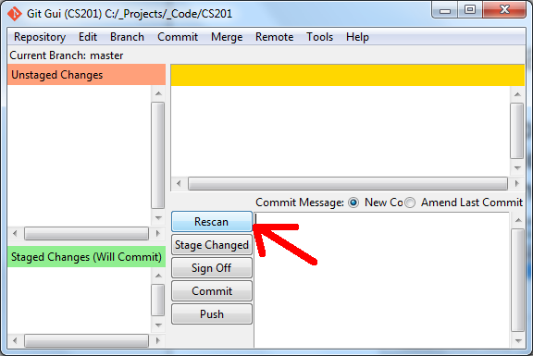
5. Adding a test file
Click on the Rescan button to refresh our file list view.

Slide 21
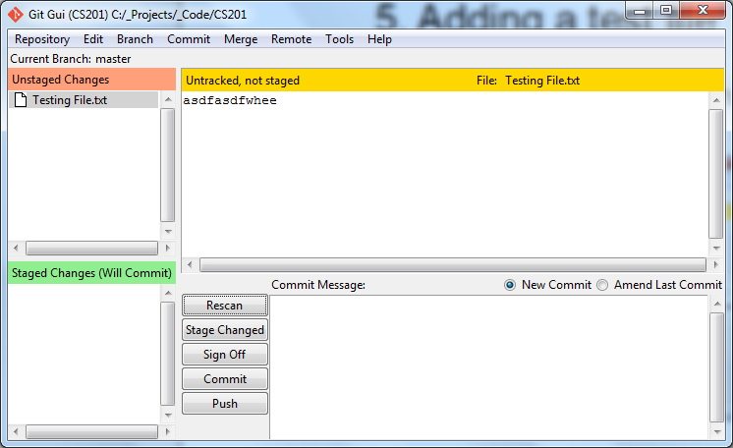
5. Adding a test file

Slide 22
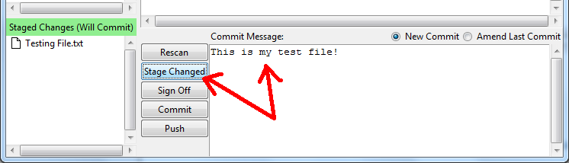
5. Adding a test file
Click on the Stage Changed button to add our changed files.
Add a commit message. Usually you should describe what you changed in the code.

Slide 23
5. Adding a test file
Click commit and the staged change will go away.
Committing is a way to keep a snapshot of changes in your code.
However, our files won't be backed up to the server until we push them.

Slide 24
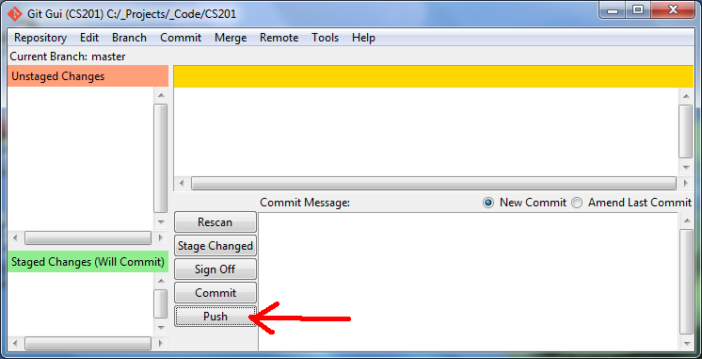
6. Pushing your changes to the server
Click on the Push button

Slide 25
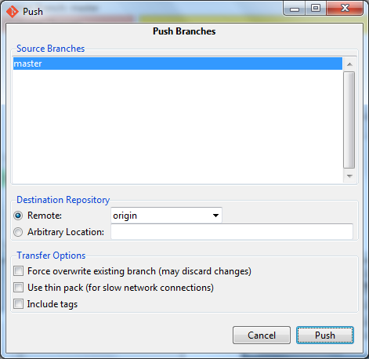
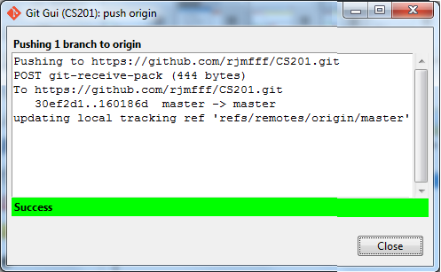
6. Pushing your changes to the server
Keep the default settings and click Push.

Slide 26
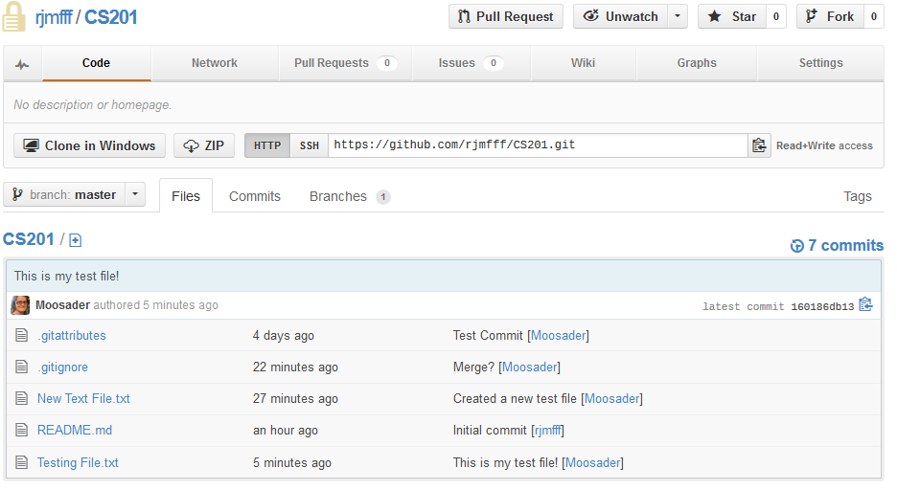
6. Pushing your changes to the server
Your changes will now be visible on the webpage.

